Slide 1
Movie Recommendation based on Graph Traversal Algorithms
Supriya Sahoo | 15IT145
Akriti Kumari | 15IT107
Ankita Bhalavi | 15IT108
Vandana Baidya |15IT250

Slide 2
Introduction
Media content recommendation is nowadays a common problem.
Choosing the right content among large amount of media content produced everyday can be difficult and overwhelming for the user.
Ex: Movies, TV Shows, TV Programs etc.

Slide 3
Introduction(Cont..)
Recommender Systems creates an accurate recommendation that suits the particular user, based on the analysis.
Two main categories of recommendation systems
content based
collaborative

Slide 4
Literature Survey
Large number of recommendation systems use a variety of methods such as content based,collaborative ,knowledge based and hybrid approach.
There are several social platforms that use this recommendation sytem approach.
In particular,we have chosen the movies databases.

Slide 5
For example :
• Netflix:
– 2/3 rented movies are from recommendation
• Google News
– 38% more click-through are due to
recommendation
• Amazon
– 35% sales are from recommendation

Slide 6
Objectives
To design a representation of the data about movies in a graph structure.
To design a method which uses data model for recommendation.
Compare various graph algorithms for recommendation and find out the best out of them.

Slide 7
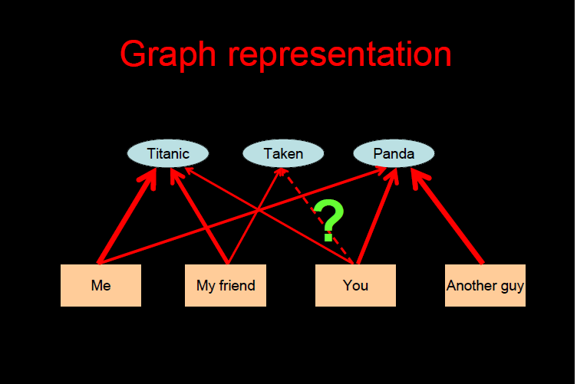

Slide 8
Methodology
UNION COLORS ALGORITHM
1) Mark each initial node with a different color.
2) Perform a simultaneous BFS from each initial node:
a) Enqueue all initial nodes.
b) Dequeue a node and visit it.
c) Add all neighbors of the visited which are yet
to be visited node into the queue.
d) Repeat from step b)
3) When a node is visited:
a) If it is yet to be colored, color it with the color
of the initial node
b) If it is already colored (with a different color),merge the two colors into one - remember that one color equals the other
4) Keep merging colors until the last two colors are
merged and only one color remains
5) Return the current and the next required number of
nodes in the queue as the result .

Slide 9
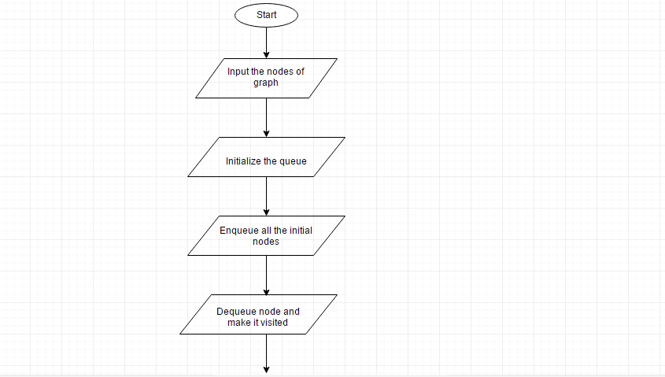
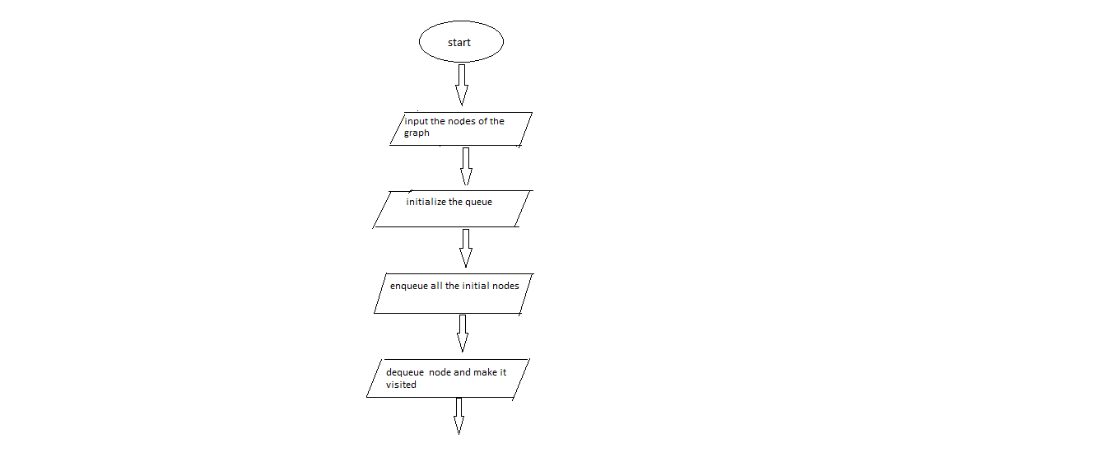

Slide 10
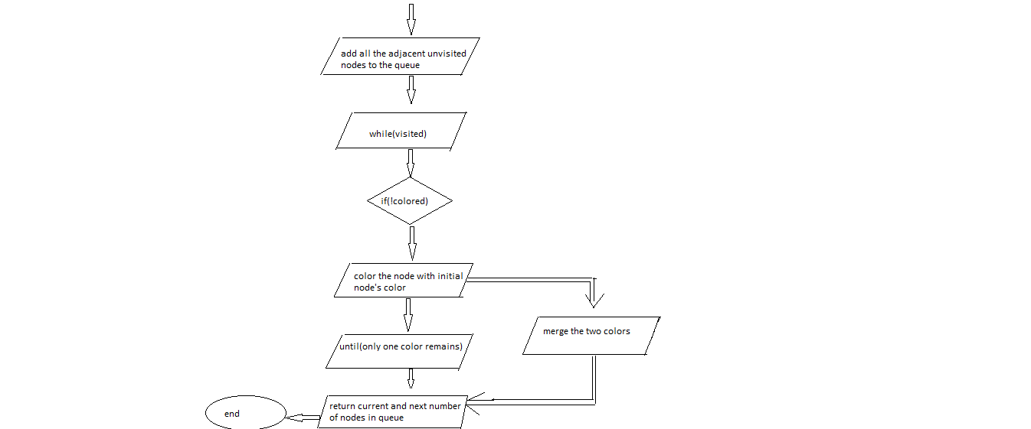
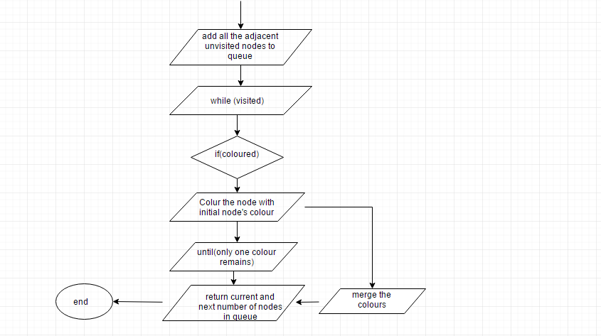

Slide 11
b. MIXING COLORS ALGORITHM :
1) Mark each initial node as visited by a different color.
2) Perform a simultaneous BFS from each initial node:
a) Enqueue all initial nodes.
b) Dequeue a node and visit it.
c) When visiting a node, mark it with the colors
of all the nodes which enqueued it.
d) Try to add all neighbors of the visited node into
the queue.
i) If the node is not in the queue, add it and remember, that it was added by the visited node.
ii) If the node is already in the queue, do not add it but remember that it has also been added by the visited node.
e) Repeat from step b)
3) Continue until the required number of nodes is colored by every color, return them .

Slide 12
c.MODIFIED DIJIKSTRA’S ALGORITHM:
Run the Dijkstra’s shortest path algorithm from each node to some constant maximal depth – calculate the shortest path from the starting node to each visited node.
a) If the algorithm is ran from the first initial node, put all visited nodes with the value of the shortest path as their total value into a results set.
b) If the algorithm is ran from other initial nodes, check if the node is in the results set. If yes, add the shortest path value to its total value.
2) Check if each node in the results set was visited from
all initial nodes.
3) Order the nodes in the results set by their total values
of the shortest paths.
4) Return the required number of nodes from the ordered
results set.

Slide 13
d. ENERGY SPREADING ALGORITHM:
1) Set the energy of each initial node to some constant value.
2) Perform a simultaneous BFS from each initial node
3) When a node is visited its energy increases by value E, E = Ep/n , where Ep is the energy of the parent node which enqueued the visited node and n is the number of nodes the parent node enqueued.
4) A node’s energy can increase multiple times, but it only spreads it when it receives energy for the first time.
5) Continue until the required number of nodes is visited from each initial node.
6) Order the nodes by their energies and return the required
number of the nodes, the more energy it has
the higher it is.

Slide 14
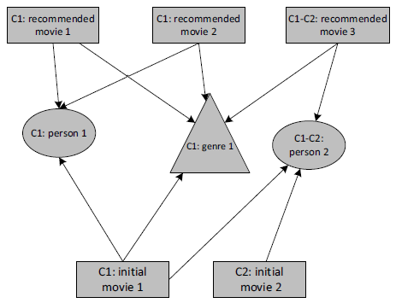
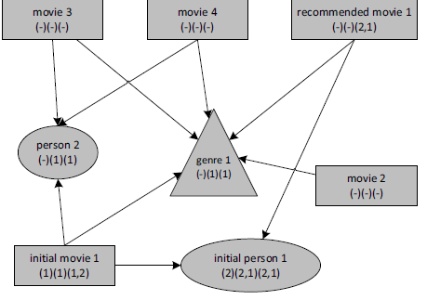
Visualisation of union colors algorithm
Visualisation of mixing colors algorithm

Slide 15
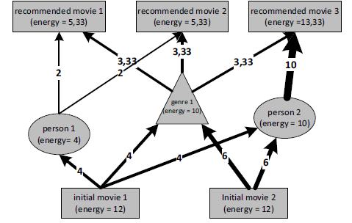
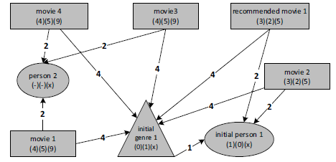
Visualisation of energy spreading algorithm
Visualisation of modified Dijikstra’s algorithm

Slide 16
Implementation
bfs get each node, push node into a max-heap, output the peak each time.
sort(movie.getSimilarMovies()) => sorted-collection return sub-sorted-collection of size numTopRatedSimilarMovies .
Make a sorted list of size top_rated and , for all connected movies add to the list if the movie rating is greater than the lowest rating of the list(that is the nth node in the list since its sorted); once you finished visiting all the connected movies the list will have the top rated movies.
use bfs to traverse the map and get each node, then push the node into a max-heap and output the peak each time

Slide 17
Implementation(contd.)
bfs -> max heap
push elements into the min heap until you complete the full traversal of the graph and meanwhile maintain the size of the min heap as equal to the number of movies asked, and keep deleting the minimum. At the end min heap will have the recommended movies.

Slide 18
EXPECTED RESULTS
As per the surveys done on the above algorithms ,according to the average rating the Union colors algorithm appears to be the best among all .
On the other hand ,the rest of the algorithms seems to be quite expensive requiring certain improvisation.

Slide 19
JUSTIFICATION
The task of collecting the raw data and information was rationally divided among the group members.
We individually undertook the task of reading various technical papers based on recommender system and graph traversal algorithm which roughly took about 3 weeks .
However ,the modification and implementation part of the project is still under process .

Slide 20
REFERENCES
(Celma & Lamere, ISMIR 2007)
F. Ricci, L. Rokach, and B. Shapira,“Introduction to recommender systems handbook,” in Recommender Systems Handbook. Springer US, 2011
Gaurav Arora,Ashish Kumar,Gitanjali Sanjay Devre,Prof. Amit Ghumare.”Movie recommendation systems based on user’s similarity,2014

